Slide 1

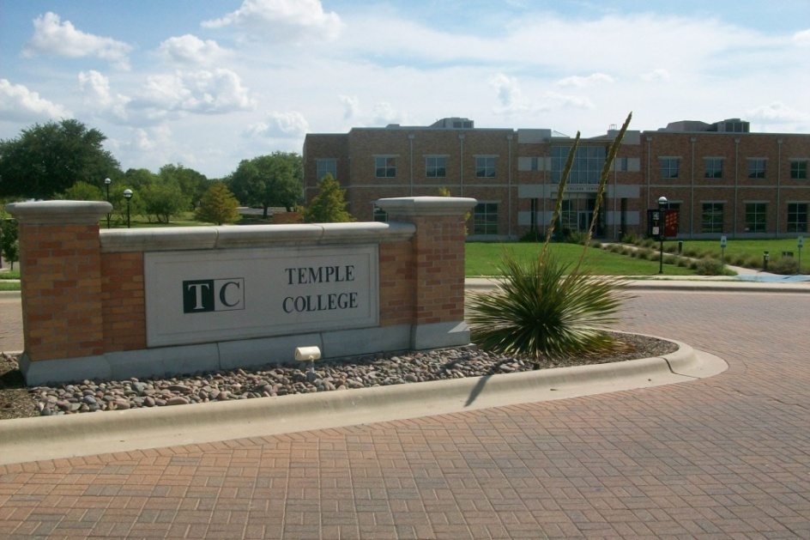
Understanding Copyright
Brian St. Amour
Distance Education
February 2009

Slide 2
Notice
Note: Much of the information for this presentation has been adapted from the following sources:
http://www.loc.gov/copyright
http://www.copyright.iupui.edu/dist_learning.htm
http://www.copyright.iupui.edu/dist_learning.htm, copyright
  http://www.copyright.iupui.edu/fairuse.htm, Fair Use
http://en.wikipedia.org/wiki/TEACH_Act, TEACH Act
  http://www.copyright.gov/legislation/dmca.pdf, Digital Millennium Copyright Act
http://www.utsystem.edu/ogc/intellectualproperty/cprtindx.htm#top, University of Texas in Austin
http://www.wellesley.edu/Library/copyright_ToC.html, Wellesley College in Massachusetts
http://www.kankakee.edu/faculty/resources/copyright/index.asp, Kankakee Community College in Illinois
http://publishing.wsu.edu/copyright/internet.html, Washington State University
http://copytight.unt.edu,University of North Texas in Denton
Permission has been granted by the following institutions to adapt their information and to link to their websites. University of Texas information © Georgia K. Harper, 2001, University of Texas System lawyer. Wellesley College information © Wellesley College, 2005, permission granted by Wellesley copyright agent Pattie Orr. Kankakee Community College information © Kankakee Community College, 2005. University of North Texas information © University of North Texas , 2008.
Photo images taken by Distance Education Department or obtained from the Temple College 2008/2009 Student Handbook.

Slide 3

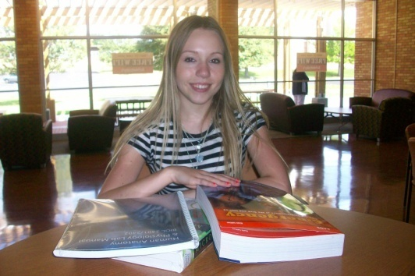
Session Overview
Institution Objectives
Copyright Law
  Copyright
  Fair Use
  TEACH Act
  Digital Millennium Copyright Act
Faculty, Staff & Student Responsibilities
Faculty Resources
Q& A Session

Slide 4
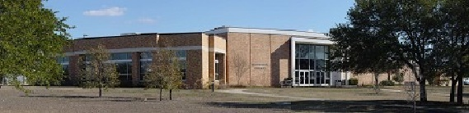
Institution Objectives
To reduce copyright risk through awareness, education and support
Educate all content users and disseminators of content about copyright policy, responsibilities and procedures

Slide 5
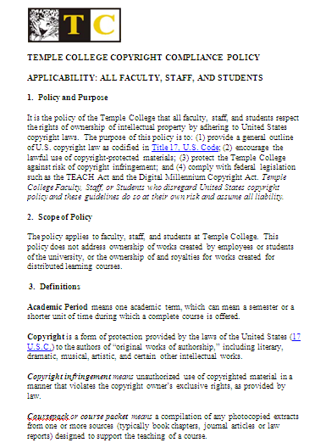
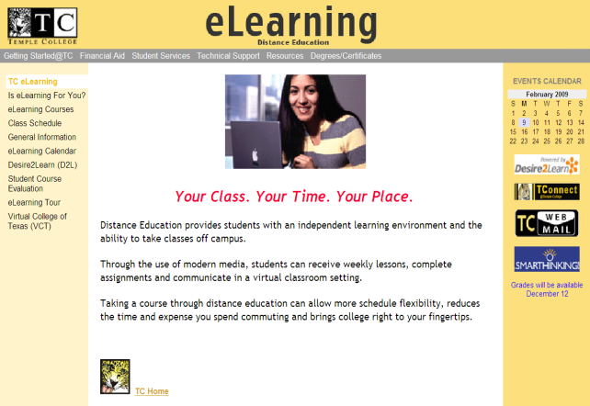
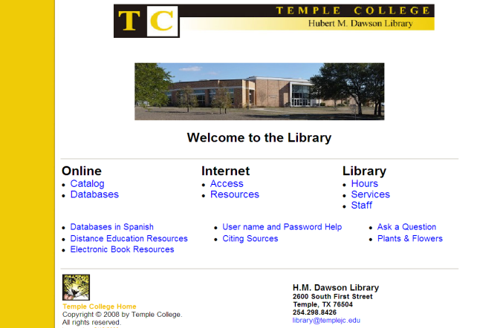
Supporting Initiatives
Update Temple College copyright policy
Conduct training workshops
Develop copyright web page
  Policy
  Resources
  Tools

Slide 6
Temple College Copyright Policy
  “It is the policy of the Temple College that all faculty, staff, and students respect the rights of ownership of intellectual property by adhering to United States copyright laws. The purpose of this policy is to: (1) provide a general outline of U.S. copyright law as codified in Title 17, U.S. Code; (2) encourage the lawful use of copyright-protected materials; (3) protect the Temple College against risk of copyright infringement; and (4) comply with federal legislation such as the TEACH Act and the Digital Millennium Copyright Act.”

Slide 7
Copyright
(1 of 4)
U.S. Copyright Law (17 U.S.C.). The U.S. Copyright Office, Library of Congress, provides informational brochures on United States copyright law and how it applies to various formats at http://www.loc.gov/copyright/
Actual U.S. Copyright Law is contained in three government documents:
  Copyright Act of 1976,
  Digital Millennium Copyright Act, and
  Technology, Education and Copyright Harmonization Act of 2002

Slide 8
Copyright
(2 of 4)
Copyright is a form of legal protection for authors of original works, including literary, dramatic, musical, artistic, and other intellectual products
Publication is not essential for copyright protection, nor is the well known © symbol
Gives the owner of copyright the exclusive right to reproduce, prepare derivative works, distribute, publicly perform or display—and to authorize others to do the same
Copyright laws are both complex and subtle

Slide 9
Copyright
(3 of 4)
Copyright Exclusions and Limitations
  Section 107: Fair Use, which applies to activities such as quoting a small portion of a book for the purposes of criticism, comment, teaching, or scholarship, or creating a parody of an artwork; and ... more info on next slide
  Section 108: Reproduction by Libraries and Archives, which applies to such activities as making archival copies, replacing lost or damaged copies, filling patron requests for photocopies, and filling interlibrary loan requests

Slide 10
Copyright
(4 of 4)
Copyright Exclusions and Limitations
  Section 109: First Sale Doctrine, which permits the lending, giving away, or resale of a physical copy of a work (such as a book or CD), providing the legal justification for lending libraries and used book stores; and
  Section 110: Noncommercial Performances and Displays, which permits certain performances and displays of copyrighted material in a face-to-face classroom, in distance education courses, in churches, restaurants, fairs, and other venues, at charitable functions held by fraternal organizations, and for the benefit of disabled persons The TEACH Act updated Section 110 in 2002 and provides an exemption for distance learning courses under specific circumstances

Slide 11
Fair Use
(1 of 5)
The doctrine of fair use, in section 107 of the Copyright Act of 1976, addresses the needs of scholars and students by mitigating the rights of copyright ownership.
Fair use expressed as guidelines rather than explicit rules
To determine fair use, consider the following four factors:
  Purpose of the Use
  Nature of the Work Used
  Amount of the Work Used
  Effect on the Use on the Market more info …

Slide 12
Fair Use: Rules
(2 of 5)
Purpose and character of the Use
  Whether the copied material will be for nonprofit, educational, or commercial use
      Teaching, scholarship or research
      Criticism or comment on a copyrighted work
      News reporting
Nature of the Work Used
  Special consideration given to the distinction between a creative work and an informational work

Slide 13
Fair Use: Rules
(3 of 5)
Amount, substantiality or portion of Used
  The proportion of the larger work that is copied and used, and significance of the copied portion
Effect on the Use on the Market
  Most critical factor in determining fair use
  Serves as the basic principle from which the other three factors are derived
  If the reproduction of a copyrighted work reduces the potential market, sales & potential profits of the copyright owner, use is unlikely to be Fair Use

Slide 14
Fair Use: Guidelines
(4 of 5)
Motion Media
  Up to 10% or 3 minutes of a source, whichever is less
Text
  Up to 10% or 1000 words, whichever is less
  An entire poem of less than 250 words, not more than 3 poems or excerpts by one poet
  No more than 5 poems or excerpts from one anthology
Music, Lyrics, Music Video
  Up to 10%, not more than 30 seconds total from an individual work

Slide 15
Fair Use: Guidelines
(5 of 5)
Illustrations, Photographs
  Not more than 5 images by one artist or photographer.
  No more than 10% or 15 images, whichever is less, from any single published work
Photocopying of Printed Materials
  One chapter from a book
  One article from a journal issue or newspaper
  Multiple excerpts from a single book or journal issue (10% or less of the total)
  A short story, short essay, or short poem
  A chart, diagram, drawing, graph, cartoon, or picture

Slide 16
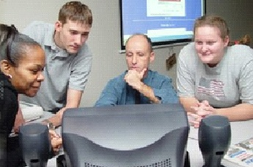
TEACH Act
(1 of 4)
Technology, Education and Copyright Harmonization Act of 2002
  Update to the copyright law;
  Act of United Stated Congress, signed into law by President Bush on 11/02/02
  Repeal of the earlier version of Section 110(2)
Permits teachers and students of accredited, nonprofit educational institutions to transmit performances and displays of copyrighted works without obtaining permission from the copyright holder in certain circumstances for distance education purposes.
Notes:
Before the TEACH Act was signed into law educators and students were at a disadvantage with respect to the materials they were allowed to use and the way in which these documents were presented through the online learning environment. The TEACH Act made copyright laws regarding distance learning similar to the laws provided for face-to-face classrooms though there are still differences. Some of these benefits include:
Instructors may use a wider range of works in distance learning environments.
Students may participate in distance learning sessions form virtually any location
Participants enjoy greater latitude when it comes to storing, copying and digitizing materials.

Slide 17
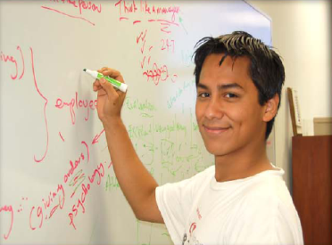
TEACH Act
(2 of 4)
Enhancements
  Expanded range of allowed works
  Expansion of receiving locations
  Storage of transmitted content
  Digitizing of analog works
Allows an instructor to distribute materials online in the quantity and of the character that he or she would otherwise have used during a face to face class.
Notes:
Before the TEACH Act was signed into law educators and students were at a disadvantage with respect to the materials they were allowed to use and the way in which these documents were presented through the online learning environment. The TEACH Act made copyright laws regarding distance learning similar to the laws provided for face-to-face classrooms though there are still differences. Some of these benefits include:
Instructors may use a wider range of works in distance learning environments.
Students may participate in distance learning sessions form virtually any location
Participants enjoy greater latitude when it comes to storing, copying and digitizing materials.

Slide 18
TEACH Act
(3 of 4)
Requirements
  Must be a government body or an accredited nonprofit educational institution
  Institute policies regarding copyright
  Provide informational materials regarding copyright
  Provide notice to students regarding copyright
  Transmission of content restricted to students officially enrolled in the course
Rights of use are often limited to certain works, in limited portions, and only under rigorously defined conditions
Notes:
Requirements
The benefits of the TEACH Act apply only to a "government body or an accredited nonprofit educational institution."
The educational institution must "institute policies regarding copyright."
The institution must "provide informational materials" regarding copyright. These materials must "accurately describe, and promote compliance with, the laws of United States relating to copyright."
In addition to the general distribution of informational materials, the institution must provide "notice to students that materials used in connection with the course may be subject to copyright protection."
The transmission of content must be made "solely for . . . students officially enrolled in the course for which the transmission is made."

Slide 19
TEACH Act
(4 of 4)
If conditions are not met, use of the material will have to qualify under fair use or have permission of the copyright holder to be lawful
Notes:
Requirements
The benefits of the TEACH Act apply only to a "government body or an accredited nonprofit educational institution."
The educational institution must "institute policies regarding copyright."
The institution must "provide informational materials" regarding copyright. These materials must "accurately describe, and promote compliance with, the laws of United States relating to copyright."
In addition to the general distribution of informational materials, the institution must provide "notice to students that materials used in connection with the course may be subject to copyright protection."
The transmission of content must be made "solely for . . . students officially enrolled in the course for which the transmission is made."

Slide 20
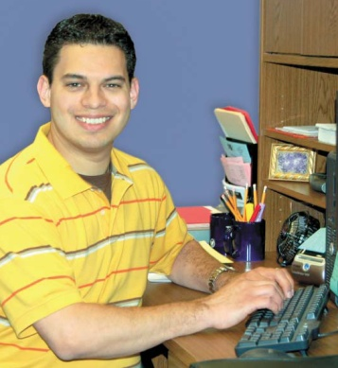
Digital Millennium Copyright Act (1 of 2)
Digital Millennium Copyright Act
  Enacted in 1998 - implements two 1996 World Intellectual Property Organization (WIPO) treaties
  Criminalizes production and dissemination of technology, devices, or services that are used to circumvent measures that control access to copyrighted works
  Increases the penalties for copyright infringement on the Internet
Notes:
Requirements
The benefits of the TEACH Act apply only to a "government body or an accredited nonprofit educational institution."
The educational institution must "institute policies regarding copyright."
The institution must "provide informational materials" regarding copyright. These materials must "accurately describe, and promote compliance with, the laws of United States relating to copyright."
In addition to the general distribution of informational materials, the institution must provide "notice to students that materials used in connection with the course may be subject to copyright protection."
The transmission of content must be made "solely for . . . students officially enrolled in the course for which the transmission is made."

Slide 21
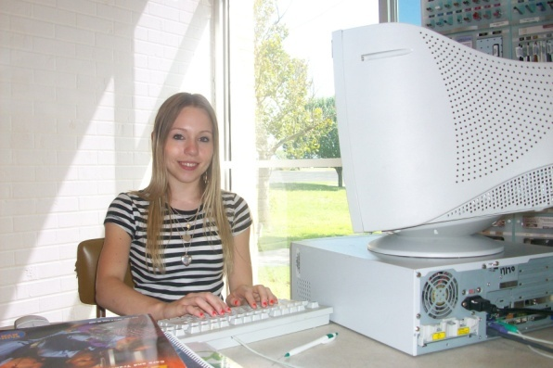
Digital Millennium Copyright Act (2 of 2)
Most common violation which occurs in university setting is illegal file sharing, especially of music files
Students and employees of TC should be aware that if they violate the DMCA either by illegally sharing copyrighted files, or in any other way, they could face severe penalties
Notes:
Requirements
The benefits of the TEACH Act apply only to a "government body or an accredited nonprofit educational institution."
The educational institution must "institute policies regarding copyright."
The institution must "provide informational materials" regarding copyright. These materials must "accurately describe, and promote compliance with, the laws of United States relating to copyright."
In addition to the general distribution of informational materials, the institution must provide "notice to students that materials used in connection with the course may be subject to copyright protection."
The transmission of content must be made "solely for . . . students officially enrolled in the course for which the transmission is made."

Slide 22
Faculty, Staff & Student Responsibilities (1 of 3)
Be compliant with TC Copyright Policy
  “Temple College Faculty, Staff, or Students who disregard United States copyright policy and these guidelines do so at their own risk and assume all liability”
Be mindful of Copyright laws
  Is the work to be used protected by copyright law?
  Is your use of the work a fair use?
  Are there any exceptions which negate the need for permission for the use of the work?
Document and keep copyright records as proof
  emails, signed permission letter, etc.

Slide 23
Faculty, Staff & Student Responsibilities (2 of 3)
Inform your students of copyright law and their responsibilities
  “Temple College Faculty, Staff, or Students who disregard United States copyright policy and these guidelines do so at their own risk and assume all liability”
Post or provide “Copyright Notice to Students” in your course(s) as needed
  Do Not Distribute notification
Restrict materials to students officially registered in your course(s)

Slide 24
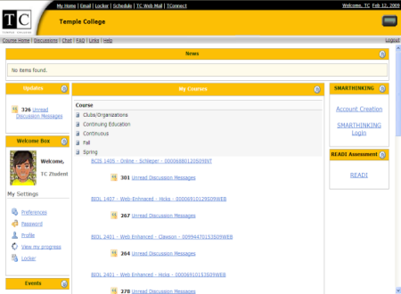
Faculty & Staff Responsibilities (3 of 3)
eLearning/Distance Education
  Obtain document permission from publishers for course cartridges/packs
    Permissions may vary by publisher or course type
    Some are free, some are fee-based
  Obtain permission for any third party materials or use apply the Fair Use rules
  Post copyright warning messages to students
  Restrict distribution of materials to students officially enrolled in a specific course

Slide 25
Distance Education (1 of 2)
More copyright restrictions apply to distance learning classrooms than to classrooms with face-to-face instruction.
Transmitted performances of nondramatic literary and musical works and displays of works are permitted in distance education under the following circumstances:
  The performance or display is directly related to and assists with the teaching content of the transmission.

Slide 26
Distance Education (2 of 2)
  The transmission is made primarily for reception in classrooms or similar places devoted to instruction
  These exemptions do not apply to the performance of dramatic works or dramatic-musical works; nor would they permit the use of motion pictures or other audiovisual works.
  Schools desiring to transmit copyrighted video, film, audiovisual works, or dramatic-musical works (such as opera or musical comedy) still need to pursue licensing rights.

Slide 27
Works That Can be Be Used Freely (1 of 2)
Some scholarly publications have articles that include a note offering the right to copy for educational purposes
Some categories of publications are in the public domain; their use is not protected by copyright law:
  Publications dated 1922 or earlier.
  Works that do not include a copyright notice and that were first published before January 1, 1978.
  Most United States government documents.
  Once a work has acquired public domain status, it is no longer eligible for copyright protection

Slide 28
Works That Can be Used Freely (2 of 2)
Economic rights have a time limit - 50 years after the creator's death
  National law may establish longer time-limits
Copyright Act of 1790
  Established U.S. copyright with term of 14 years with 14-year renewal
Copyright Act of 1976
  Extended term to either 75 years, or 50 years after the creator's death; also as extended copyright to tangible works, even if unpublished
  For more information go to http://www.wipo.int/copyright/en/faq/faqs.htm

Slide 29
The Internet
Content on the internet is not public domain unless specified
Assume that any images are copyrighted unless otherwise stated
Fair use rules apply
Search for “open source” information sites such as Wikipedia (but be careful)
  http://en.wikipedia.org/wiki/Main_Page
Leverage online libraries for licensed software
  Microsoft Office Online resources

Slide 30
Photos & Images
Avoid copying or otherwise using images you find on web pages without permission of the copyright owner
No copyright notice is necessary on photos or images
Assume copyright unless otherwise stated
Do not copy images you believe to be public domain
Do not copy, modify or display images

Slide 31
Video
Can a Temple College-owned video be copied for reserve use?
  Not unless permission for the copying has been obtained from the copyright owner.
May a club or other group show a video obtained from a local video store?
  No. However, many film/video libraries and distributors offer the required "public performance rights" that are included in a higher rental fee.

Slide 32
Music (1 of 3)
Music is the most restricted and licensed of all forms of copyright protected works
Music that can be used in education without permission or license:
  An original composition and instructor is either the composer or has the composer's permission;
  Popular recorded music and instructor has the permission of the publisher(s) or copyright owner(s);
  Used in distance education and instructor complies with all requirements of the TEACH Act;
  Qualifies under rigorous Fair Use exemption rules; or
  Copyright has expired or was donated to the Public Domain

Slide 33
Music (2 of 3)
To Further Clarify
  If music is played on a special Web site as part of distance education and otherwise complies with all prerequisites under the TEACH Act, then it will be exempt from the requirement of getting permission or paying licensing fees
  If music is played live in class for the purpose of education or research, it may be exempt from permission and license fees as Fair Use
  A majority of the four factors of Fair Use would have to favor fair use so music may have to be edited so that entire songs are not played
Instructor

Slide 34
Music (3 of 3)
Acceptable to record a performance of a work from sheet music not under copyright
  Instructor performs and records
Distance Education Courses: Include a “COPYRIGHT NOTICE TO STUDENTS” statement in the assignment
  “This recording is for the sole purpose of instruction as part of this course offered by Temple College, is solely for Temple College students registered in this course, and is subject to copyright protection law.”

Slide 35
Faculty Resources
Employee Handbook
TC Web Site
  Web Links
  Resources
  Permission Letter
  FAQs
Professional Development
Library & Distance Ed. Dept.

Slide 36
Copyright Tools
Policy
  Updated policy in final approval process
  Current Policy available
Permission Letter
  Sample
Web Site
  In planning phase

Slide 37
Web Information Sites (1 of 2)
Copyright
  http://www.loc.gov/copyright
Fair Use
  http://www.copyright.iupui.edu/fairuse.htm
TEACH Act
  http://www.copyright.iupui.edu/dist_learning.htm
  http://en.wikipedia.org/wiki/TEACH_Act
Digital Millennium Copyright Act
  http://www.copyright.gov/legislation/dmca.pdf
The Campus Guide to Copyright Compliance
  http://www.copyright.com/Services/copyrightoncampus/basics/teach.html

Slide 38
Web Information Sites (2 of 2)
The Campus Guide to Copyright Compliance
  http://www.copyright.com/Services/copyrightoncampus/basics/teach.html
Educational Fair Use Guidelines For Distance Learning: The Conference on Fair Use
  http://www.utsystem.edu/ogc/intellectualproperty/distguid.htm

Slide 39
Q&A Session
Questions, comments, discussion
  brian.stamour@templejc.edu
  (254) 298-8388, or
  Temple College Library

